Slide 1



Exercice-Lab 4
View in Power BI
Last data refresh:
2/6/2019 1:31:16 PM Romance Standard Time
Downloaded at:
2/7/2019 9:28:03 AM Romance Standard Time

Slide 2
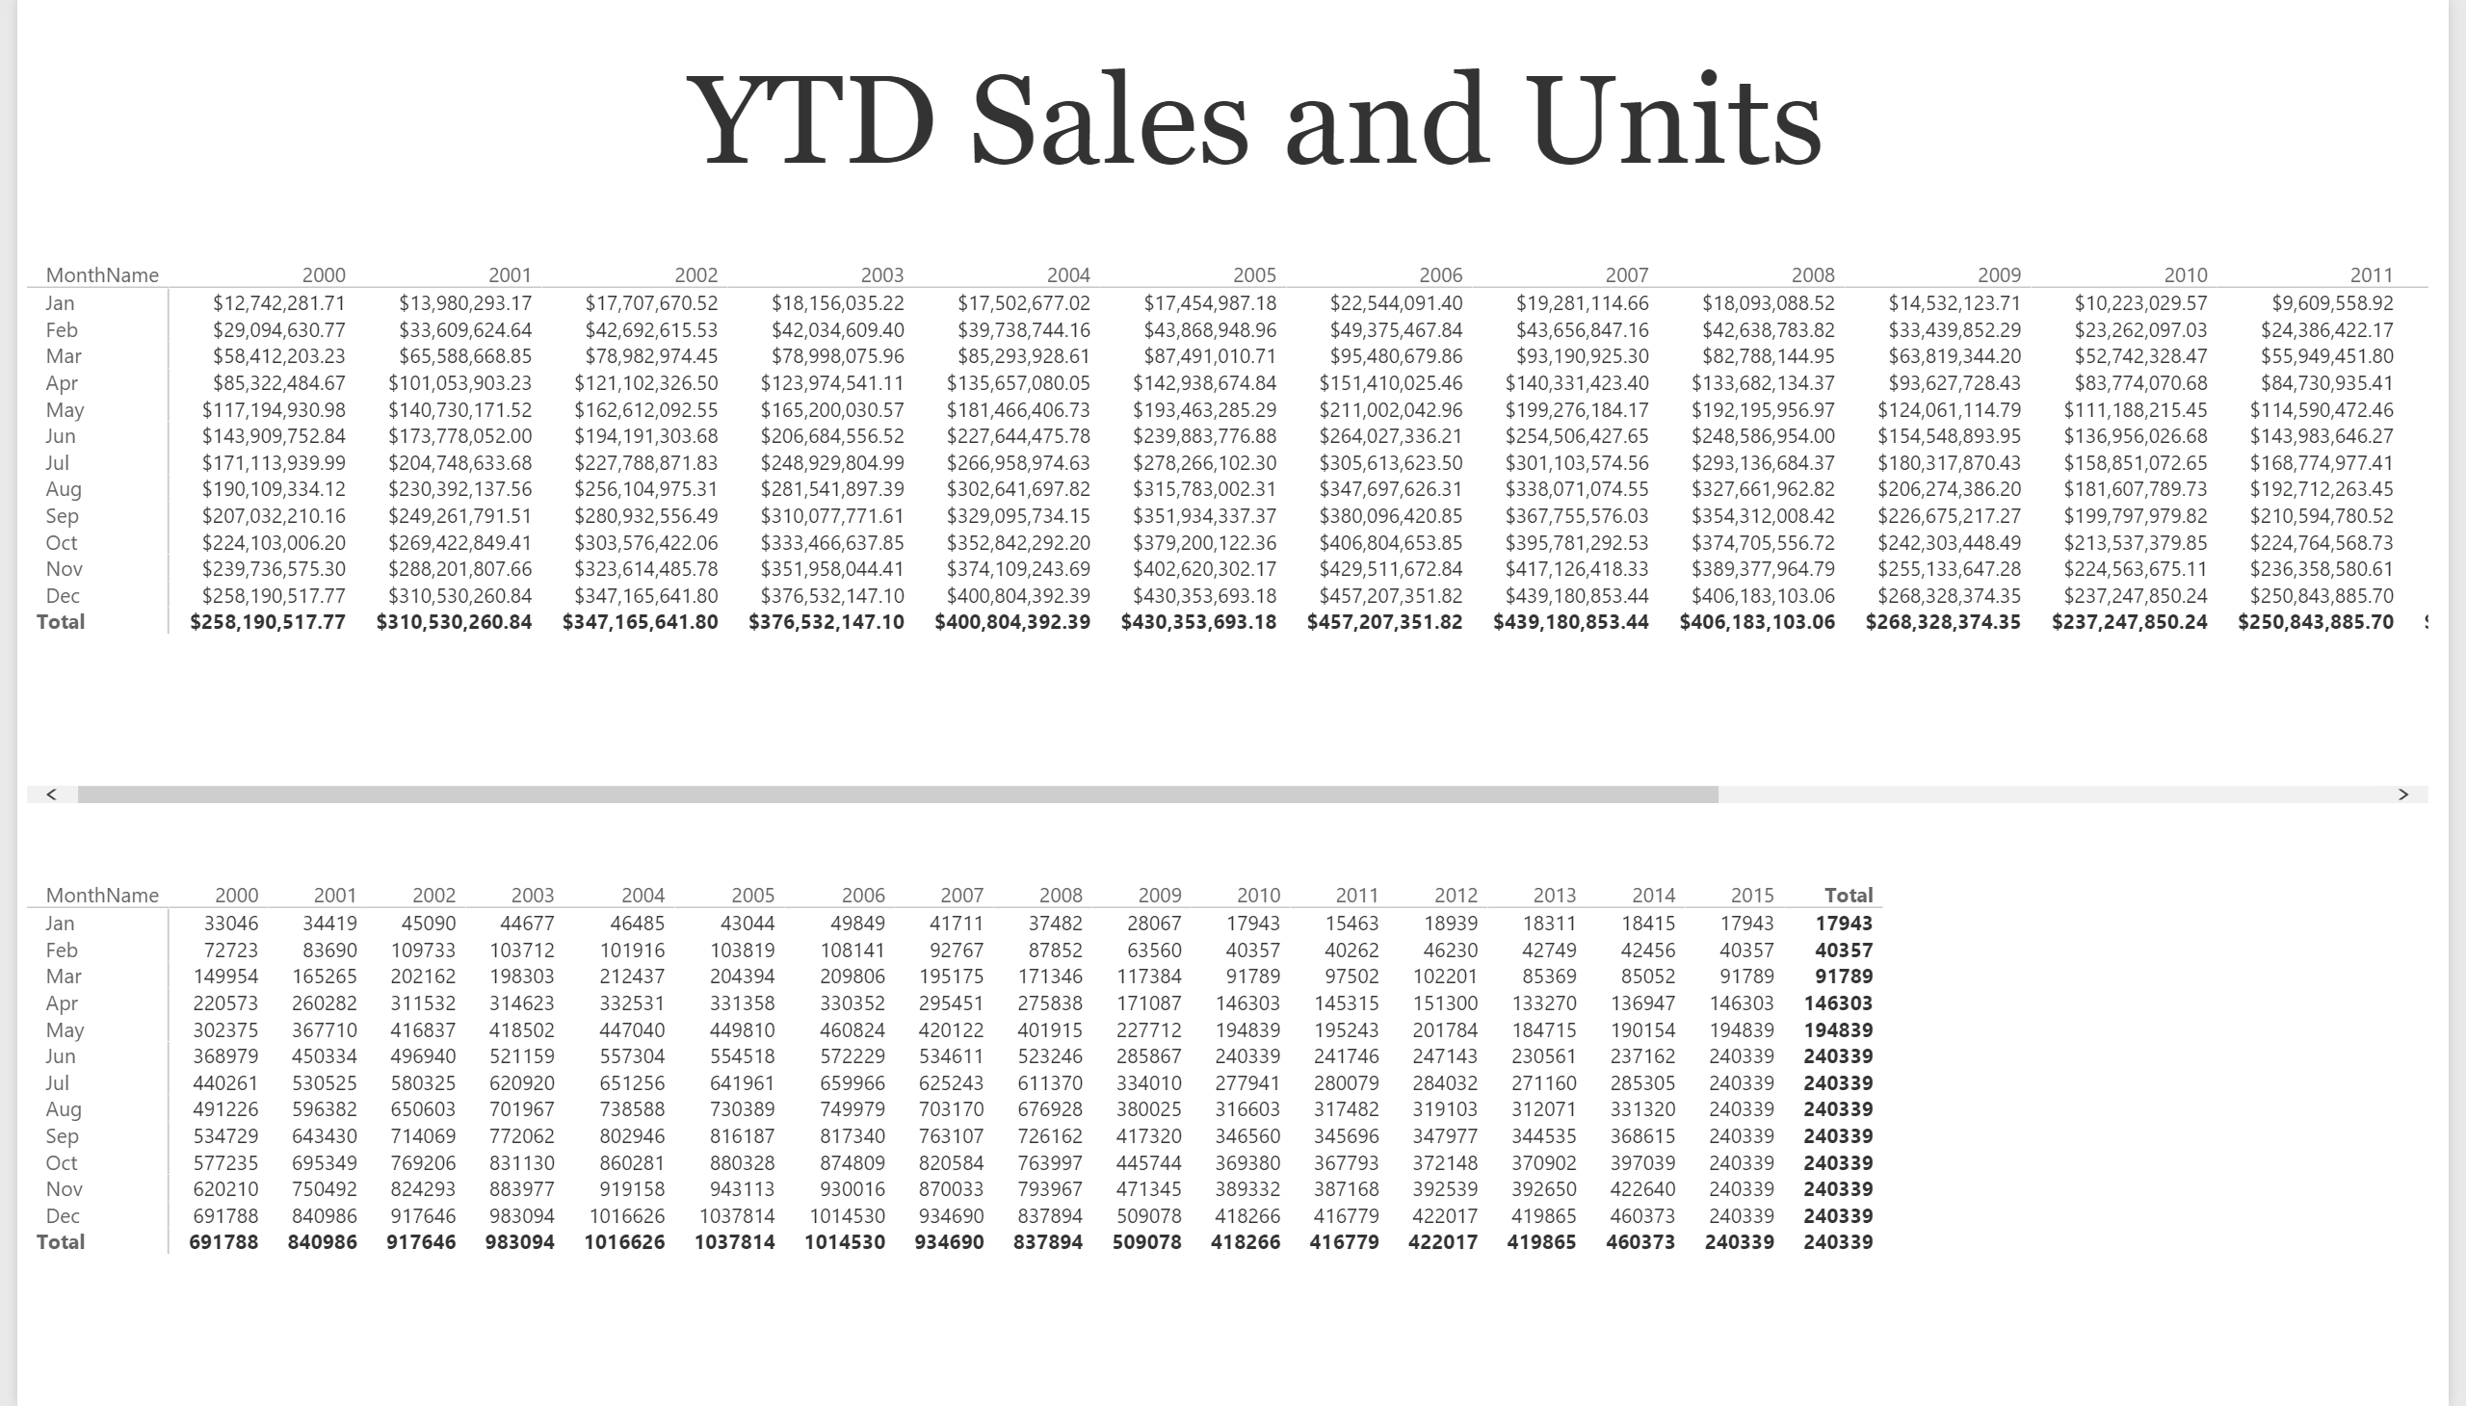

Slide 3
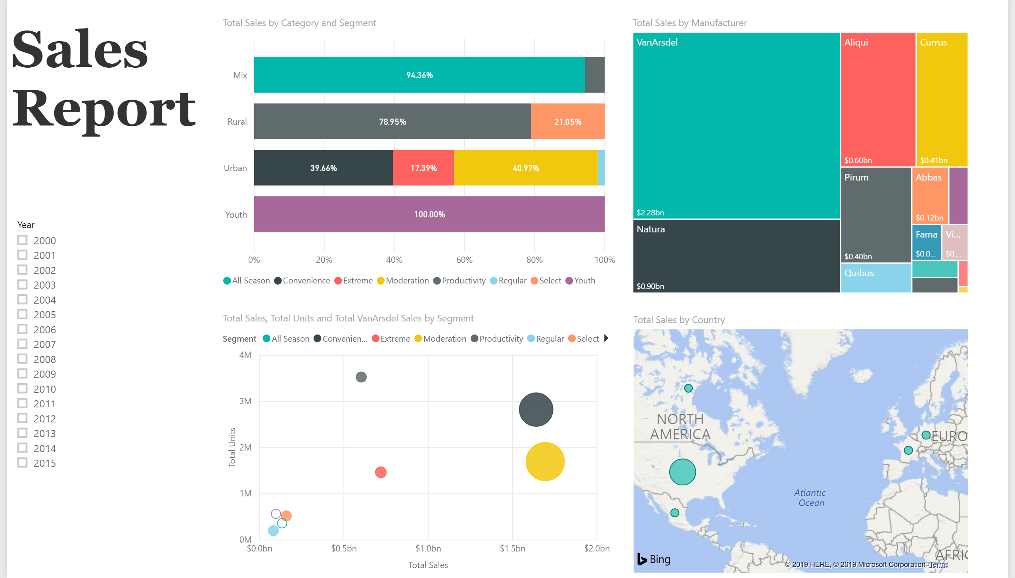

Slide 4
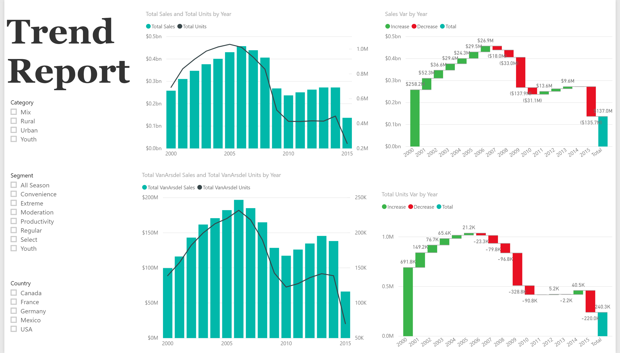

Slide 5
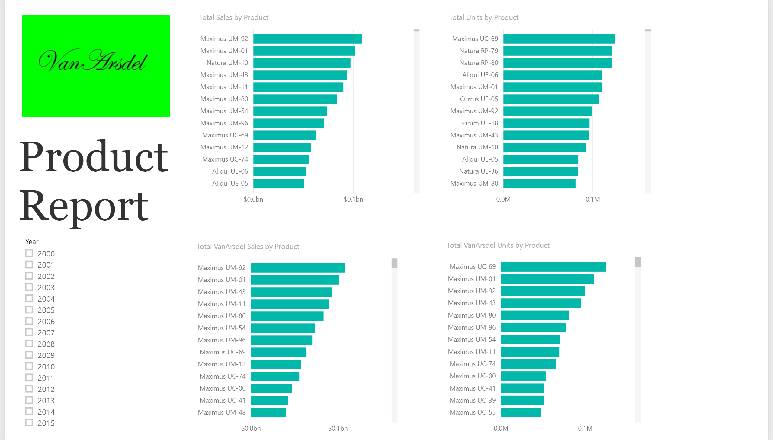

Slide 6
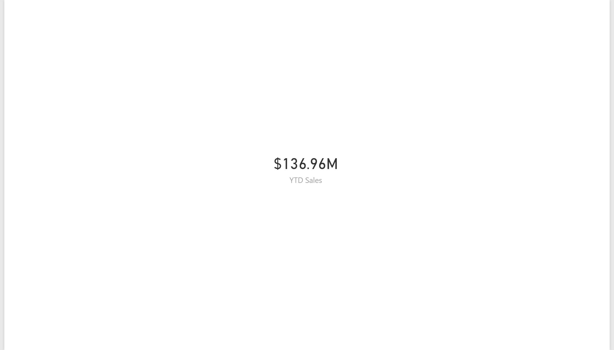

Slide 7
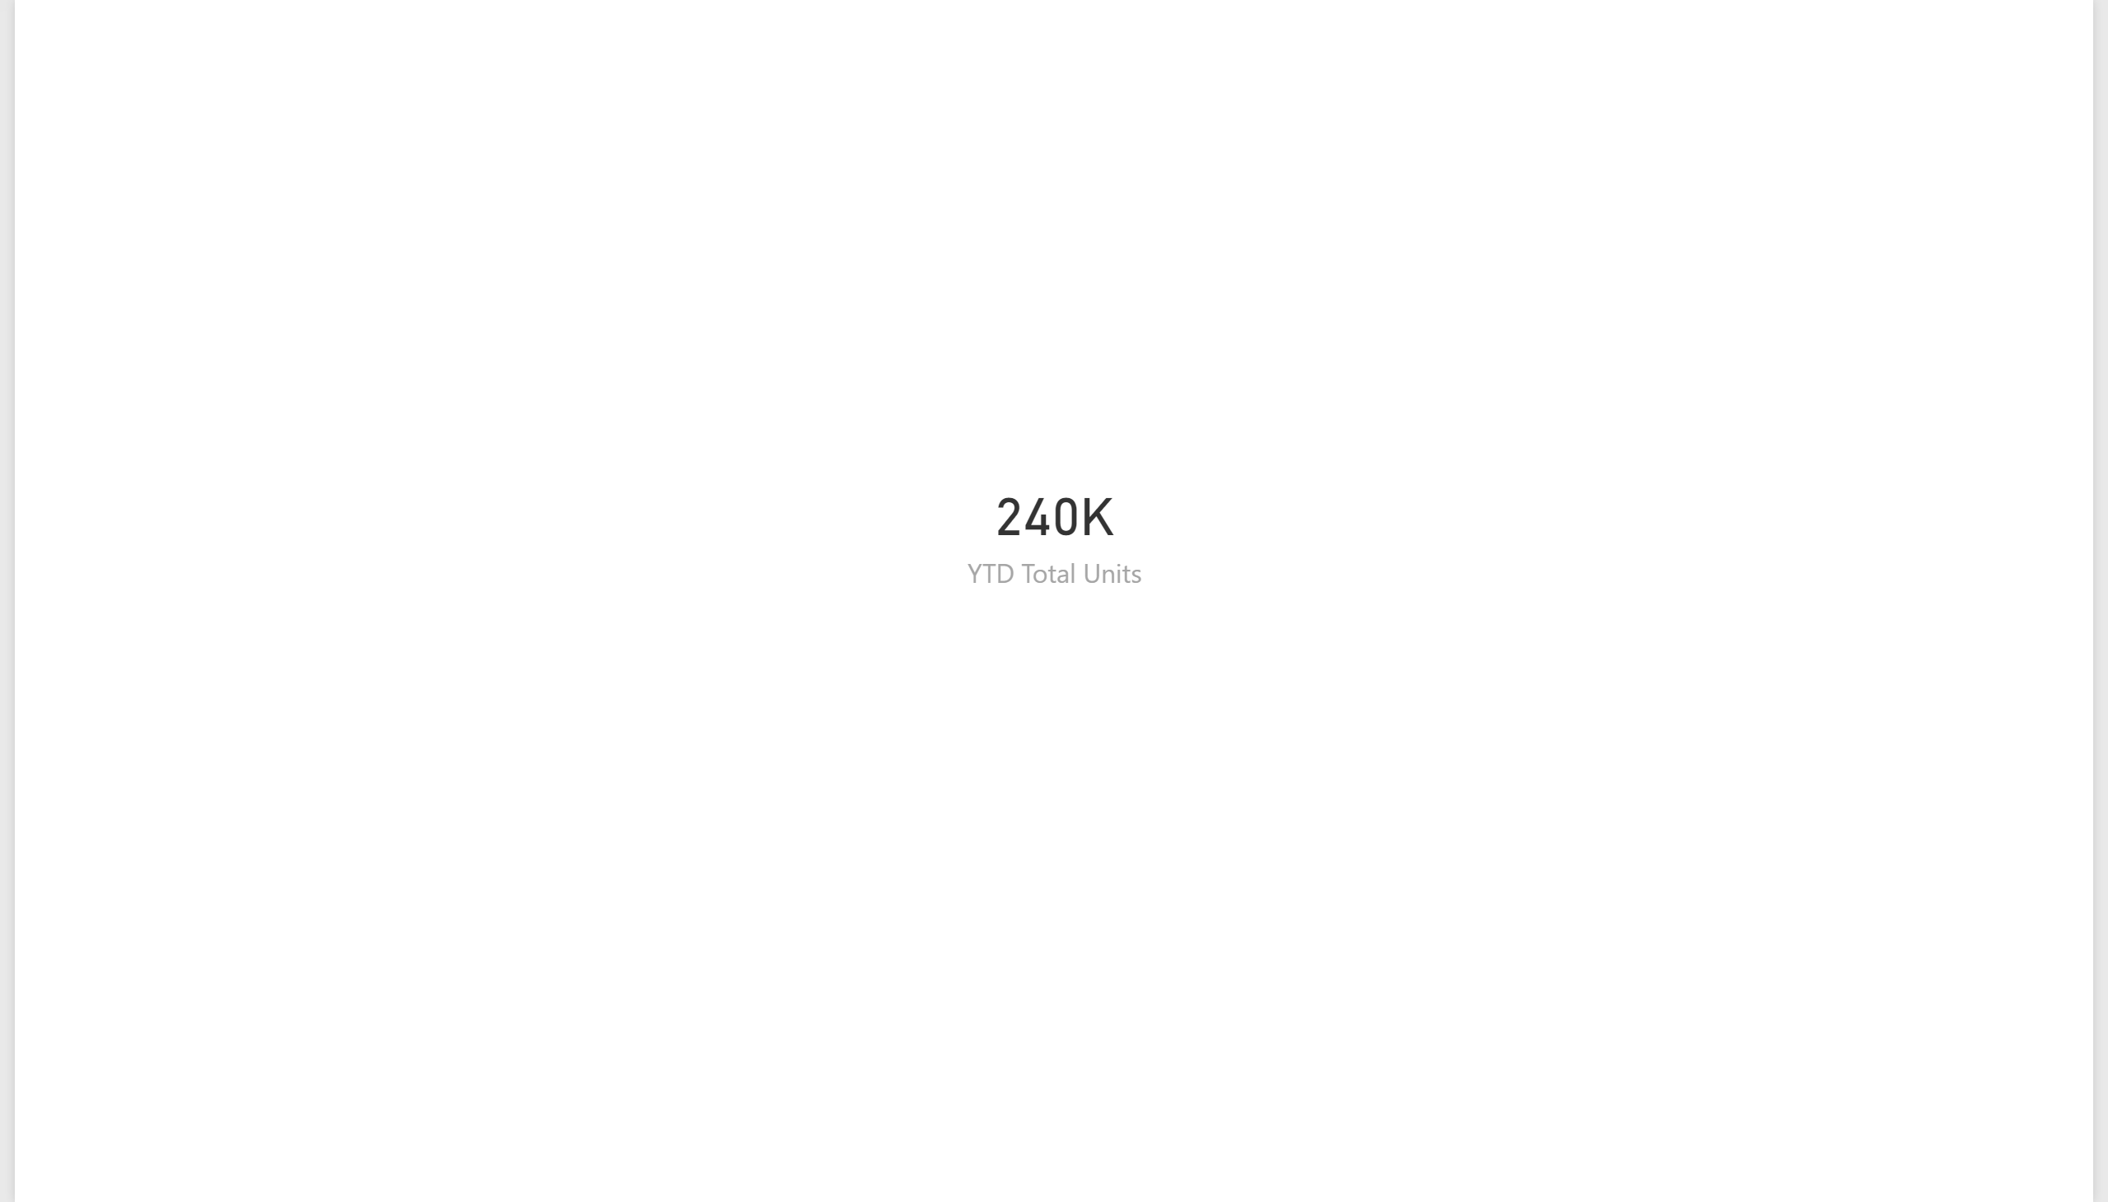

Slide 8
